Slide 1
Heuristic Evaluation: City Clerk Site
Findings & Recommendations

Slide 2
What is a Heuristic Evaluation?
A testing method for finding low-hanging usability issues
We evaluated the City Clerk’s site and compared it against accepted usability principles
We reviewed the site based on four thematic areas:
Value
Presentation
Wayfinding & IA
Trust

Slide 3
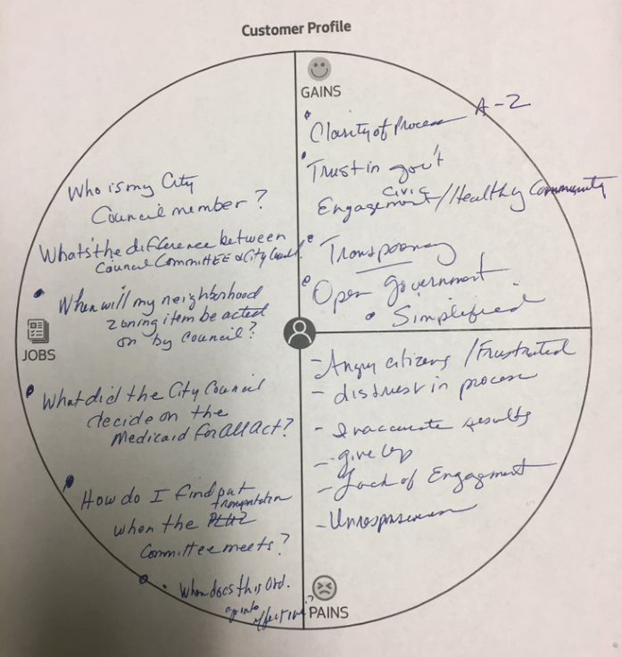

Target Audience & Task List
People new to the legislative process
Task 1: Who is my city councilmember?
Task 2: When will my neighborhood zoning item be acted on by council?
Task 3: What did the city council decide on the Medicaid for all act?

Slide 4
Overall Findings
Needed Improvements

Slide 5
Value
-- Is there evidence I can complete my task?
Value is not always clear.
The functionality to support many tasks are embedded from outside systems without context
e.g. Links audiences to Legistar without warning
Find my councilmember tool is located in multiple places, which is confusing
Evidence indicating where to find council decisions is not clear at-a-glance

Slide 6
Presentation
-- Do layouts support scanning & use best practices?
Icons are not easy to understand
Same icon used for different content items
Icons used do not accurately represent the content
Text is not legible in Legistar and form is difficult to fill out on mobile
Page uses space effectively and no big empty areas were present
Form fields are not placed in a logical order
Advance search fields are not hidden and filtered search fields are displayed inconsistently
Thumbnails do not function as expected
Thumbnails link to external documents while content links to a different page
Notes:
Layout of the contents and elements

Slide 7
Wayfinding & IA
-- Does navigation use best practices?
Audiences cannot tell where they are in the site
Navigation links to other sites and body links go to external applications without an obvious way to go back
Menu category and link names are not mutually exclusive in navigation and home pages
Duplicate content across multiple pages
Tasks flow can be more efficient
First time users land on advanced search
audiences must leave the current site to use the find councilmember tool

Slide 8
Trust
-- Does the site perform well?
"Find councilmember" tool does not present privacy and security polices in context when audiences are inputting their address
Tool doesn't prevent errors by giving an input example
Tool does not provide clear feedback in response to audiences’ actions
Loading error when other content is inputted
No context to let humans know that they are leaving the City Clerk’s page

Slide 9
Recommendations
Low hanging fruit

Slide 10
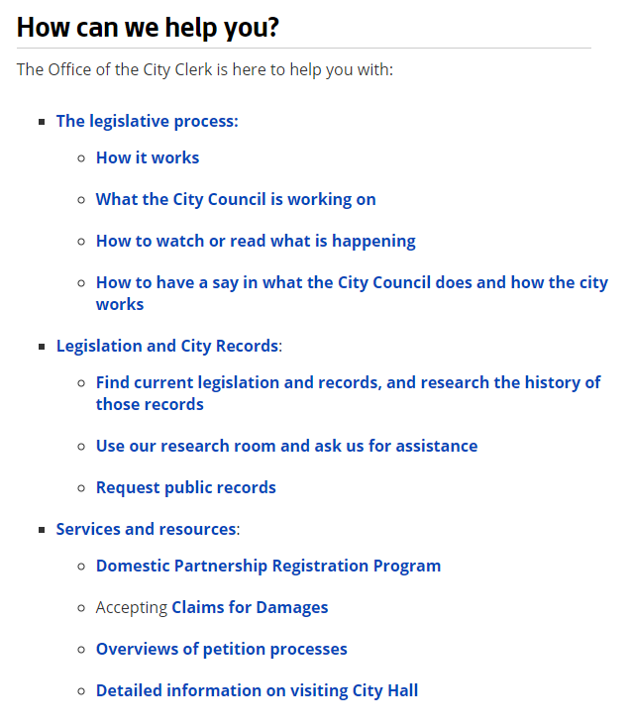
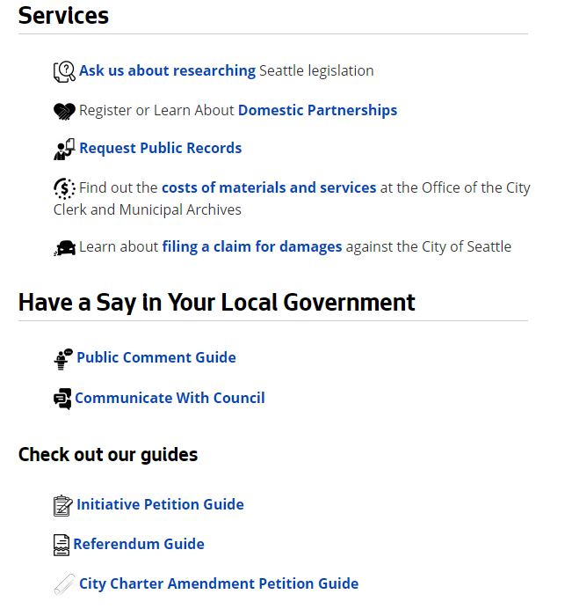
Consolidate duplicate content
Identify duplicate content and functionality across the council and city clerk site and consolidate information
About
City Clerk Services
Notes:
Urls under images – label images

Slide 11
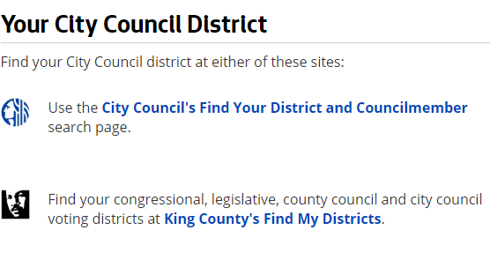
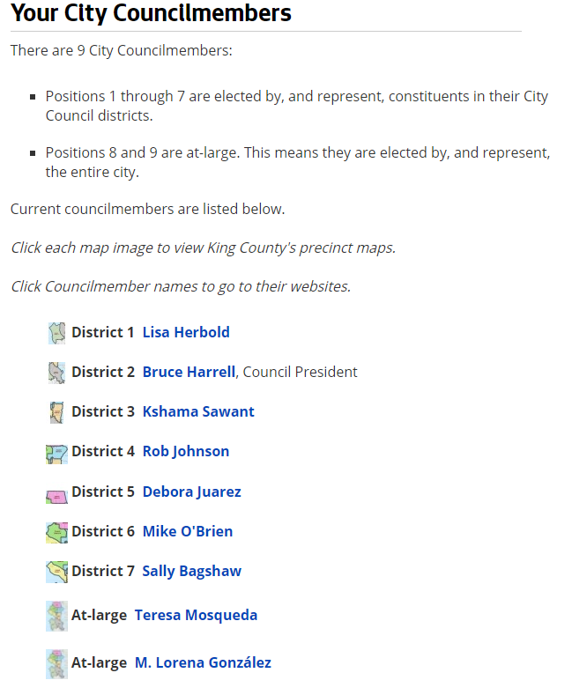
Remove Duplicate Functionality
"Found councilmember" tool is placed in too many locations – consolidate and link out to one place

Slide 12

Consolidate councilmember search
Collaborate with Council
Let audiences restart when incorrect information is inputted
Let audiences know what you’re doing with their information to address privacy concerns

Slide 13
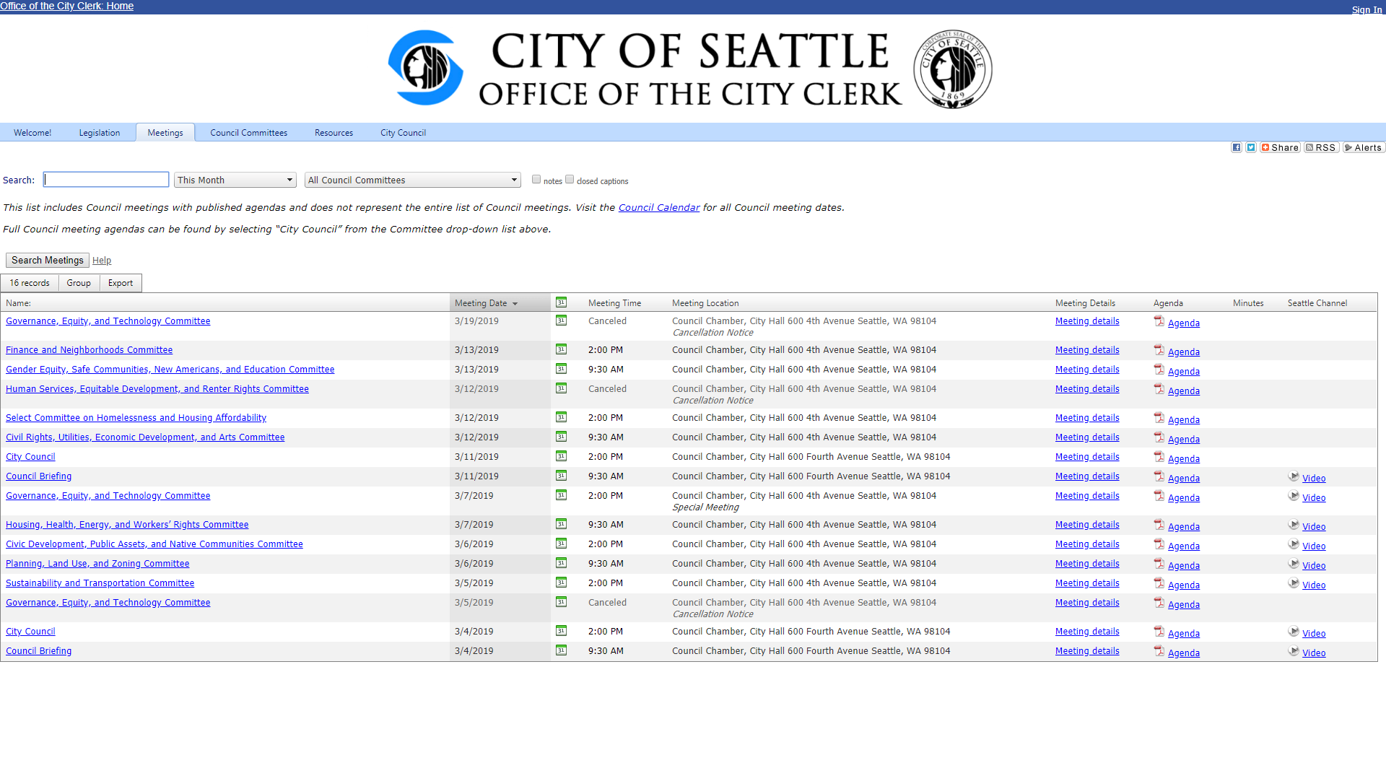
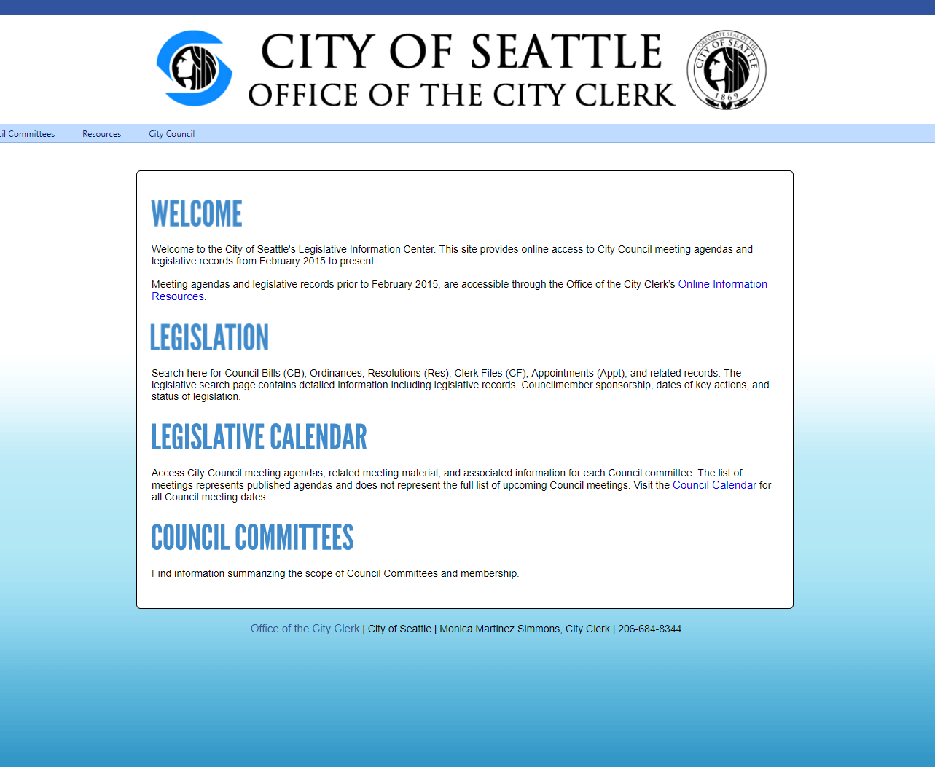

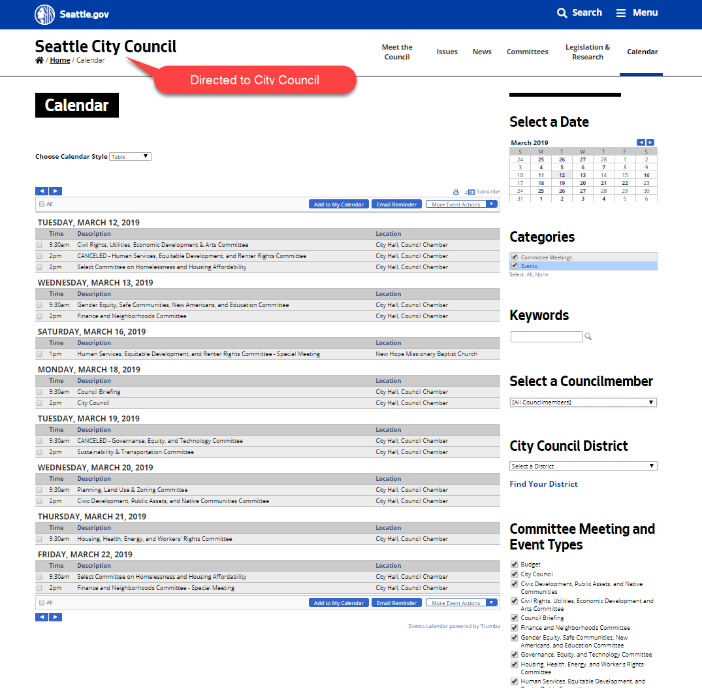
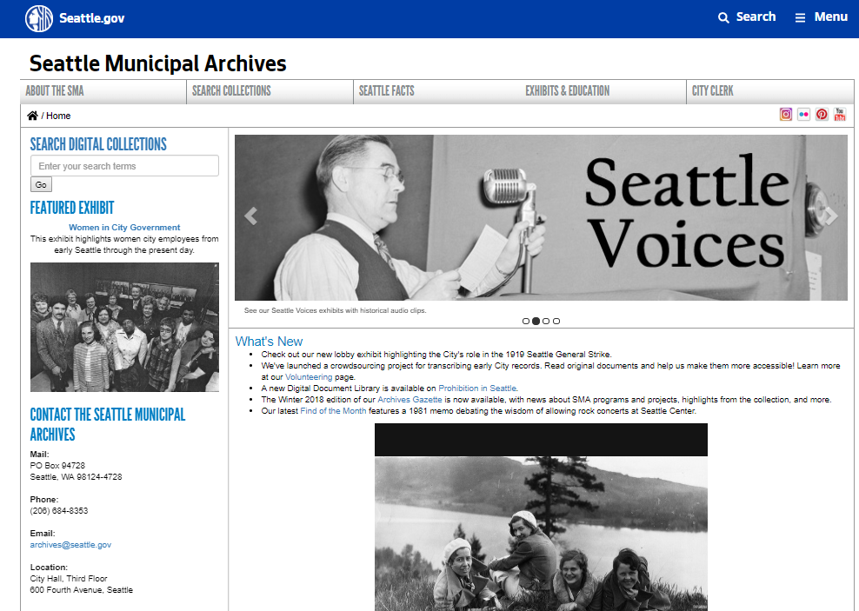
Alert the user when they are leaving the site
Use an icon and/or text that indicates they will be redirected.

Slide 14
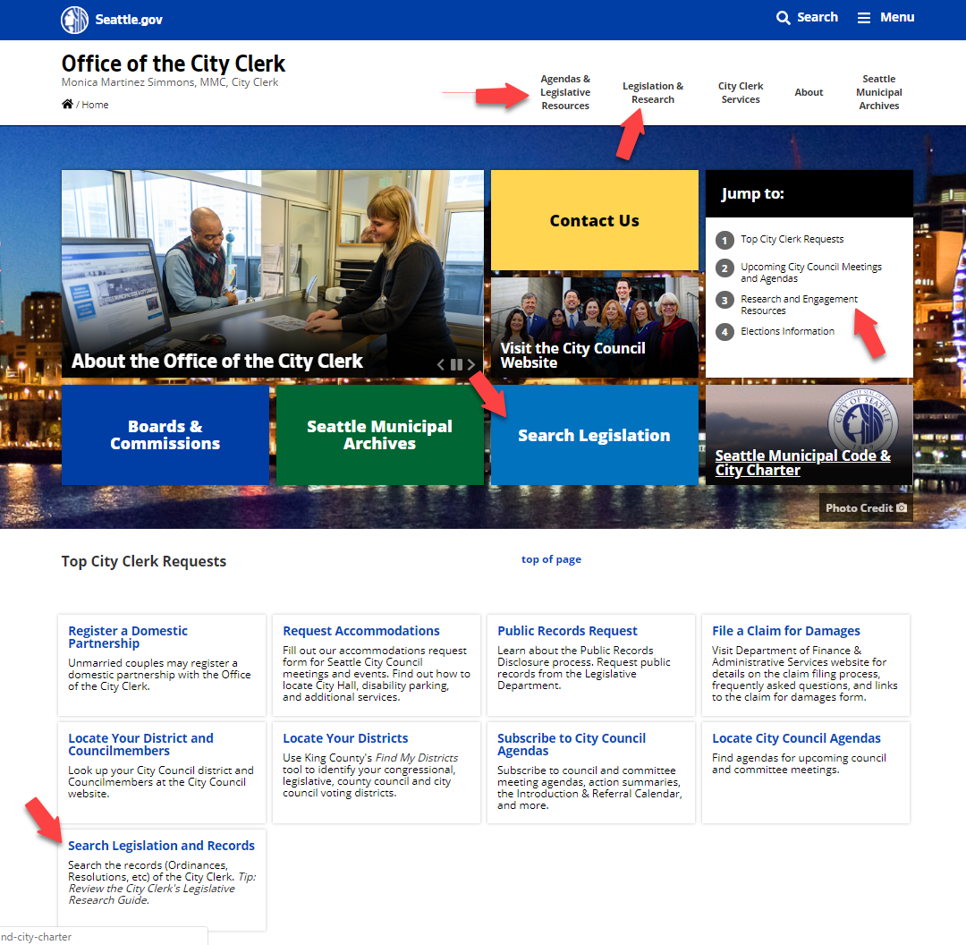
Label menu category and link names clear & mutually exclusive
Remove cards that are similar
Move duplicate links to the sidebar
Consider consolidating the first two navigation items that have duplicate content

Slide 15
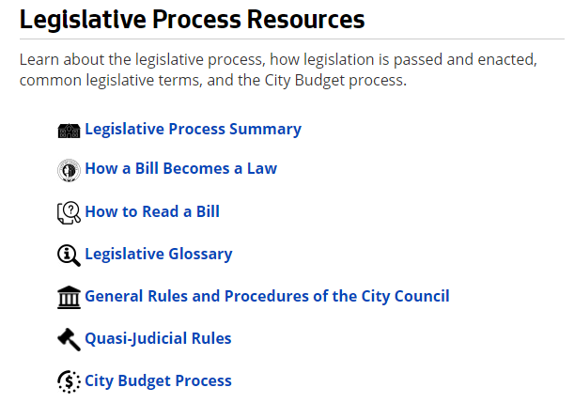
Avoid overusing icons
Use icons at the heading/category level
Use familiar visuals for icons
Use same icon styling for consistency

Slide 16
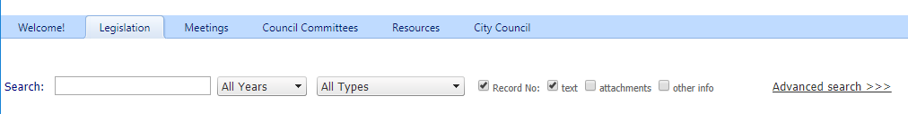
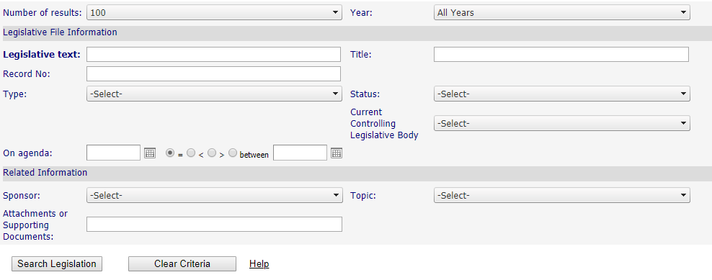
Optimize Search forms
Show simple search form on page load
Remove political jargon in Legistar form fields
Provide contextual help by surfacing the terms glossary
Evaluate existing form fields and remove fields that are low in usage or not needed
Add a toggle for staff if they use all advance search fields
Notes:
Toggle for staff if they use the advance fields

Slide 17
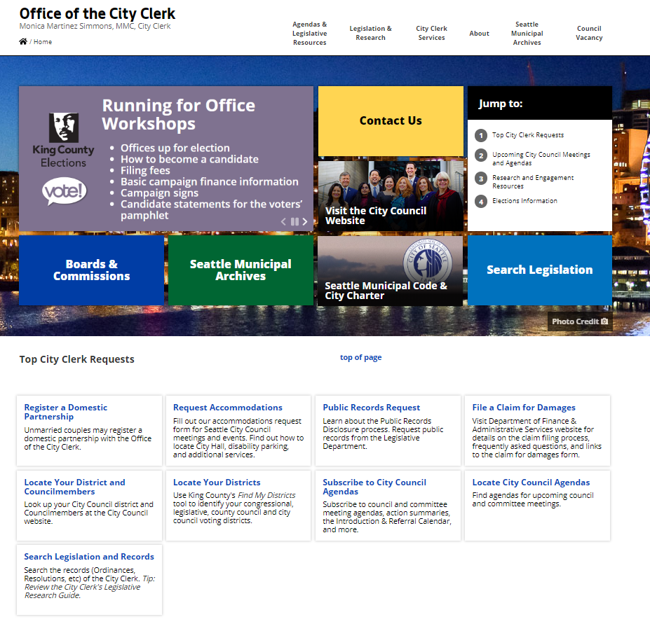
Optimize Home Page
Optimize for the first time visitor by surfacing just the main functionalities onto the homepage
Remove links that take visitors outside of seattle.gov from the home page

Slide 18
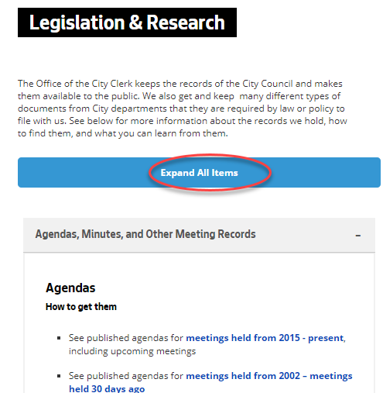
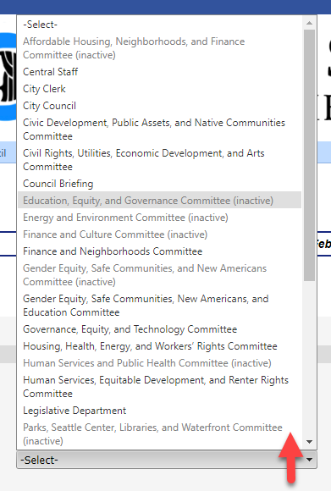
Match the interactive function with audience expectations
When the accordion is expanded label "Collapse All Items"
In Legistar the dropdown opens upward and is not a standard pattern

Slide 19
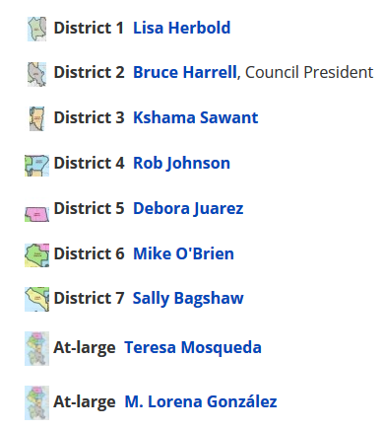
Supporting icons and thumbnails should behave as expected
Label the maps more clearly or link thumbnails the same way as the councilmember names

Slide 20
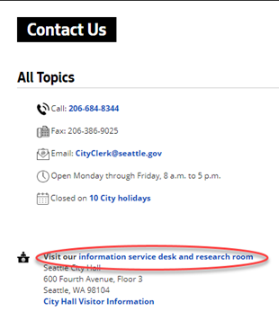
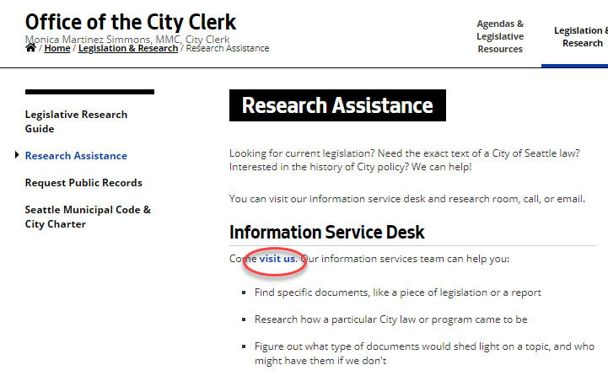
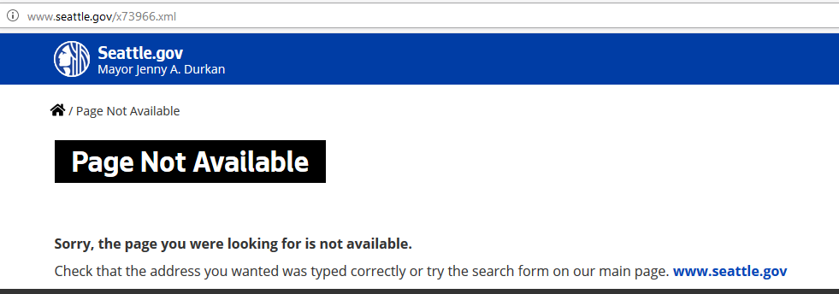
Site performance Improvements
Fix links that prevent the user from completing a task. These links create a loop
Check for broken links. The About page linked to a page that wasn’t available
Notes:
Put a plug for site improve

Slide 21
Improvements for the future

Slide 22
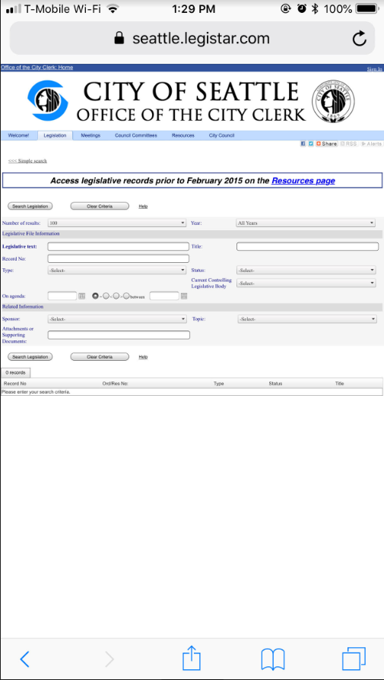
Responsive Legistar
Re-design for mobile first
Test the functionality and legibility on mobile devices
Update branding to be consistent with Seattle.gov

Slide 23
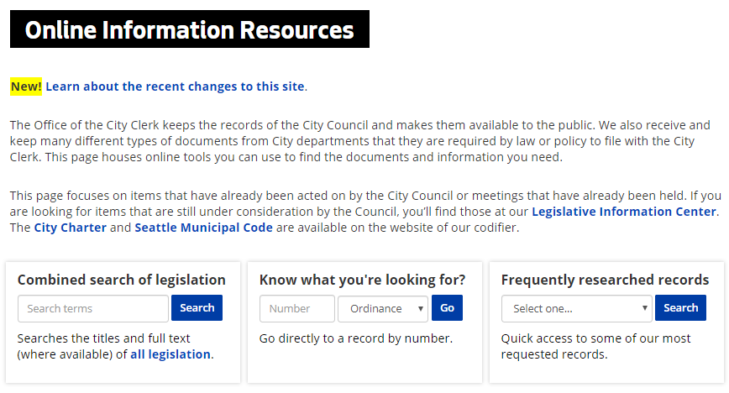
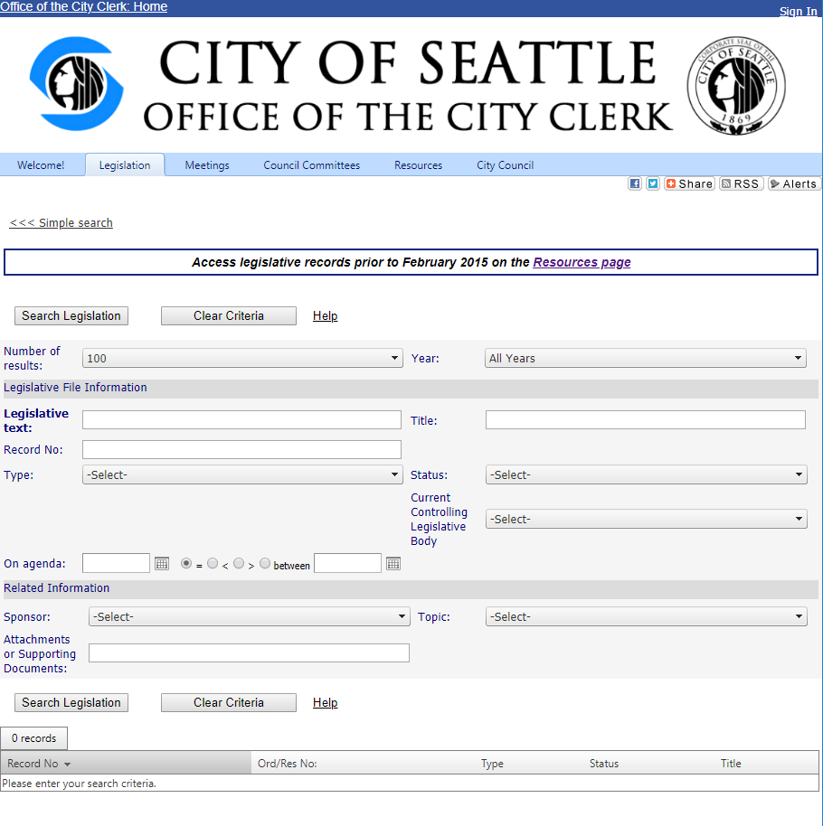
Consolidate search
Audiences should be able to search for keywords, ordinance # and titles in one field
Consolidate databases to allow audiences to only use one universal search and then filter as needed
Display one prominent search field with a link to the alternative search
Notes:
One search and link for older items

Slide 24
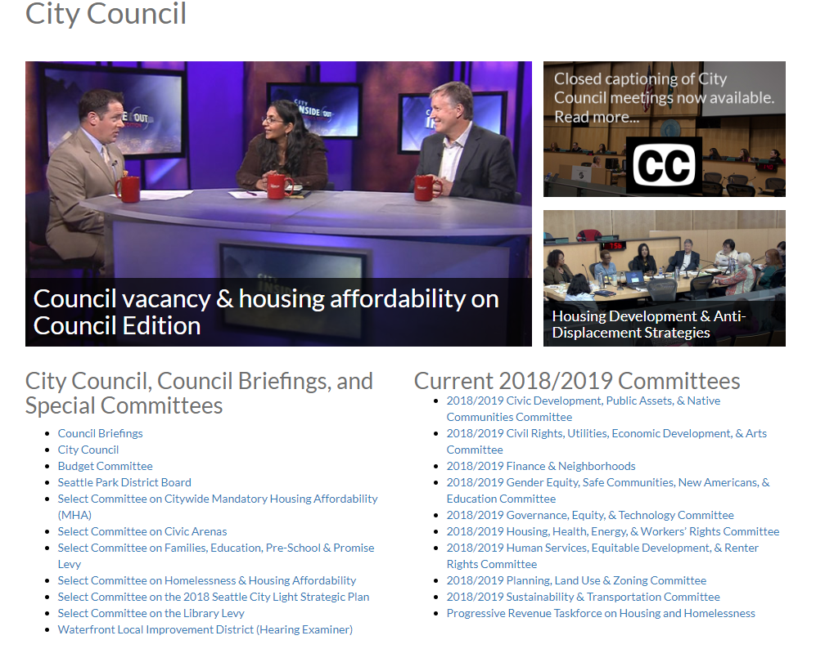
Consolidate with other departments
Collaborate with City Council and Seattle Channel on defining specific user goals/paths through their sites to reduce redundancies
This way each destination will support specific needs, without overlapping content

Slide 25
Next Steps
Act on the low-hanging fruit
Conduct a user journey mapping exercise to define touch points across sites / channels
Evaluate content to map them to your users’ journey
Inventory your content
Affinity mapping exercise to re-organize content
Create site map for new site architecture

Slide 26
Questions?
For any help or consulting needs, put a request in Service Hub.​
Analytics – request the Getting Started Guide.​
Accessibility & Site Management​
Request an account for Site Improve, which lets you know where you have broken links, how you can fix accessibility issues and will give you an indication of how complex your site’s language is by giving you a reading level grade.
Attend training sessions
Learn how to organize your website
Evaluate your website

